Slide 1
Hotel Reservation Analysis
Project 1
With SQL
@MENTORNESS
Batch: MIP-DA-04
By Dharmindar Ram

Slide 2
Hotel Reservation Analysis With SQL
Agenda
Overview
Approach Used
Key Areas
Questions/Insights
Recommendations
By Dharmindar Ram @MENTORNESS

Slide 3
Overview
Hotel Reservation Analysis With SQL
Key Skills Practised
MySQL(Mainly GROUP BY, ORDER BY and Aggregate Functions)
Data Analysis(SQL)
Business Insights(SQL, Excel(Pivot Tables))
By Dharmindar Ram @MENTORNESS

Slide 4
Hotel Reservation Analysis With SQL
Overview
Project Purpose
Perform some analysis on the given dataset to understand the data to bring out insights and help hotel industry understand their business and make decisions based on historical data.
By Dharmindar Ram @MENTORNESS

Slide 5
Hotel Reservation Analysis With SQL
Overview
About Project
You are given a dataset containing some data of hotel industry and asked to answer some questions and generate insights. You have to analyze data using SQL.
By Dharmindar Ram @MENTORNESS

Slide 6
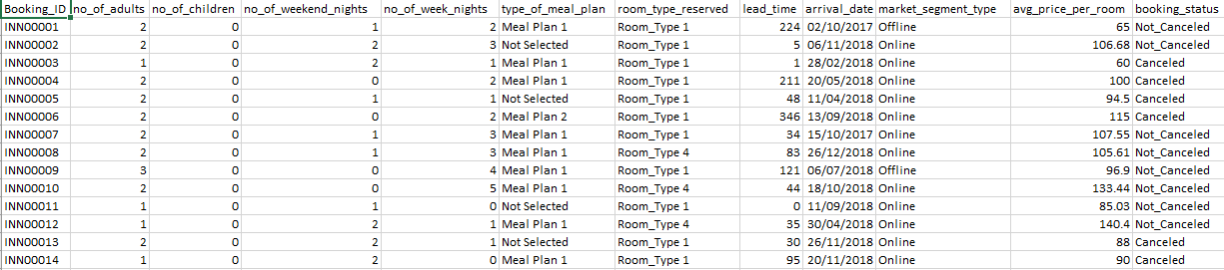
Hotel Reservation Analysis With SQL
Overview
About Data
Raw dataset contains 12 columns and 700 records.
By Dharmindar Ram @MENTORNESS

Slide 7
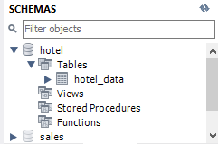
Hotel Reservation Analysis With SQL
Approach Used
Approach Steps:
Created a schema in MySQL Workbench named ‘hotel’, created table named ‘hotel_data’ with all the columns and imported data from csv file.
Performed queries to answer the business questions.
By Dharmindar Ram @MENTORNESS

Slide 8
Hotel Reservation Analysis With SQL
Key areas
Year wise reservations
Weekend nights and weeknights breakdown
Top meal plans
Month wise bookings
Top market segments
Most reserved room
By Dharmindar Ram @MENTORNESS

Slide 9

Hotel Reservation Analysis With SQL
Questions/insights
1. What is the total number of reservations in the dataset?
Insights
There are total 700 reservations in the dataset.
By Dharmindar Ram @MENTORNESS

Slide 10
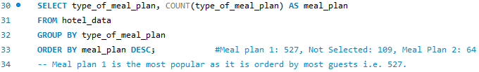

Hotel Reservation Analysis With SQL
Questions/insights
2. Which meal plan is the most popular among guests?
Insights
Meal Plan 1 is the most popular meal plan among guests.
In 527 out of 700 reservations meal plan 1 was ordered.
By Dharmindar Ram @MENTORNESS

Slide 11

Hotel Reservation Analysis With SQL
Questions/insights
3. What is the average price per room for reservations involving children?
Insights
For every room in the reservation involving children, there is different average price per room.
By Dharmindar Ram @MENTORNESS

Slide 12

Hotel Reservation Analysis With SQL
Questions/insights
4. How many reservations were made for the year 20XX (replace XX with the desired year)?
Insights
For the year 2018, there are total 577 reservations.
This is 82.43% of the total reservations, it means the year 2018 is the leading year for getting more reservations.
By Dharmindar Ram @MENTORNESS

Slide 13
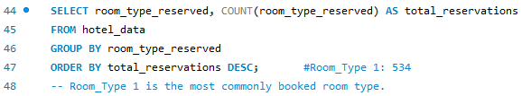
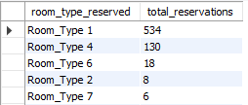
Hotel Reservation Analysis With SQL
Questions/insights
5. What is the most commonly booked room type?
Insights
The most commonly booked room type is Room_Type 1.
More than 500 reservations have Room_Type 1 booking.
This is 76.29% of the total reservations in the available dataset.
By Dharmindar Ram @MENTORNESS

Slide 14


Hotel Reservation Analysis With SQL
Questions/insights
6. How many reservations fall on a weekend (no_of_weekend_nights > 0)?
Insights
Total 383 reservations fall on weekend.
It means the number of reservations having weekend nights are less than reservations having week nights.
By Dharmindar Ram @MENTORNESS

Slide 15

Hotel Reservation Analysis With SQL
Questions/insights
7. What is the highest and lowest lead time for reservations?
Insights
The lowest lead time is 0 while highest lead time is 443.
By Dharmindar Ram @MENTORNESS

Slide 16
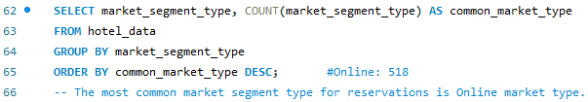
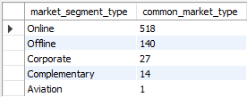
Hotel Reservation Analysis With SQL
Questions/insights
8. What is the most common market segment type for reservations?
Insights
The most common market segment type for reservations is Online market segment.
By Dharmindar Ram @MENTORNESS

Slide 17


Hotel Reservation Analysis With SQL
Questions/insights
9. How many reservations have a booking status of "Confirmed"?
Insights
There is no “Confirmed” booking_status in the dataset.
There are only two statuses i.e. Canceled and Not_Canceled
By Dharmindar Ram @MENTORNESS

Slide 18


Hotel Reservation Analysis With SQL
Questions/insights
10. What is the total number of adults and children across all reservations?
Insights
Total number of guests including adults and children is 1385 across all reservations as per given dataset.
By Dharmindar Ram @MENTORNESS

Slide 19


Hotel Reservation Analysis With SQL
Questions/insights
11. What is the average number of weekend nights for reservations involving children?
Insights
The average number of weekend nights for reservations involving children is 1.
By Dharmindar Ram @MENTORNESS

Slide 20
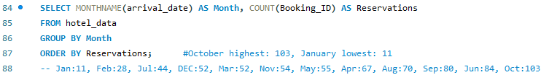
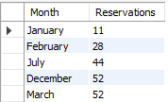
Hotel Reservation Analysis With SQL
Questions/insights
12. How many reservations were made in each month of the year?
Insights
The reservations made in each month of the year are as following:
Jan:11, Feb::28, Jul:44, Dec:52, Mar:52, Nov:54, May:55, Apr:67, Aug:70, Sep:80, Jun:84, Oct:103
October got highest (103) and January got lowest 11 reservations.
By Dharmindar Ram @MENTORNESS

Slide 21

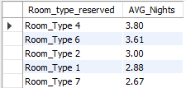
Hotel Reservation Analysis With SQL
Questions/insights
13. What is the average number of nights (both weekend and weekday) spent by guests for each room type?
Insights
Room_Type 4 got highest average as of 3.80 and Room_Type 5 got the lowest average as of 2.50
By Dharmindar Ram @MENTORNESS

Slide 22
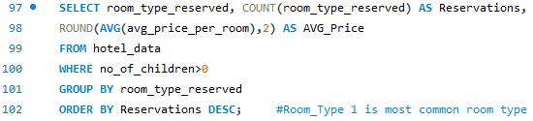
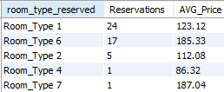
Hotel Reservation Analysis With SQL
Questions/insights
14. For reservations involving children, what is the most common room type, and what is the average price for that room type?
Insights
Room_Type 1 is the most common room type of all reservations involving children
By Dharmindar Ram @MENTORNESS

Slide 23
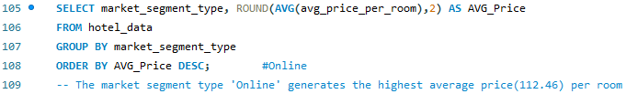
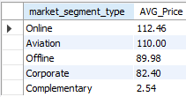
Hotel Reservation Analysis With SQL
Questions/insights
15. Find the market segment type that generates the highest average price per room.
Insights
The market segment type ‘Online’ generates the highest average price(112.46) per room
By Dharmindar Ram @MENTORNESS

Slide 24
Hotel Reservation Analysis With SQL
Recommendations
The year 2018 is the leading year in getting highest 82.43% reservations off all time and it is 369% more than previous year 2017 So, keep improving the quality of meal plans and improve customer services to generate more sales as sales are increasing if we compare to previous year.
Room_Type 1 got 76.29% reservations of all time, Always keep maintaining room type 1 for better customer service.
By Dharmindar Ram @MENTORNESS

Slide 25
Hotel Reservation Analysis With SQL
Recommendations
Through online market 518 reservations got booked which is 74% of all reservations So, to improve sales for more revenue, prefer marketing of the hotel online and give offers.
Meal plan 1 is most loved by guests so give discounts on meal plan 1 and improve quality as well.
By Dharmindar Ram @MENTORNESS

Slide 26
Thank You

